Slide 1
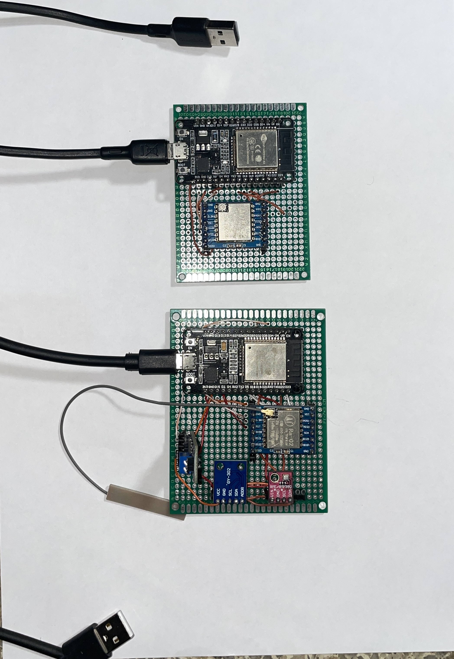

DEPARTMENT OF ELECTRONICS AND ELECTRICAL ENGINEERING EEE307 GROUP DESIGN
DESIGN AND CONSTRUCTION
OF A WIRELESS
WEATHER STATION
SUPERVISED BY: DR A. A. FISUSI
GROUP MEMBERS
AGBOOLA OLUWATOBI I.
AKINSANYA IMOLEOLUWA
OJOLO ANUOLUWAPO
OLAGUNJU ALEX I.
OMONIYI ALIYY A.
USMAN AHMAD J.

Slide 2
OUTLINE:
INTRODUCTION
PROBLEM
STATEMENT
AIM AND
OBJECTIVES
LITERATURE
REVIEW
METHODOLOGY
RESULTS
AND
IMPACTS
CONCLUSION
AND
RECOMMENDATION

Slide 3
INTRODUCTION
The weather can greatly impact human activities and has caused significant damage in
Nigeria due to unreliable forecasts. Weather forecasting relies on data analysis and
meteorology, but is often inaccurate and requires human interaction. The weather station
offers a solution by removing human error and providing a user-friendly system for
accurate weather forecasting. The weather station is designed to be inexpensive, portable,
and small in size. It can be used as an outdoor or indoor unit to sense the humidity,
rainfall, temperature e.t.c.

Slide 4
AIM AND OBJECTIVES
The aim of this project is to construct a weather station that is able to sense multiple
weather conditions( Humidity, Temperature, Rainfall, Pressure, Altitude, Dew Point,
and Light intensity); simultaneously, at specific time intervals for a given coverage
and eliminate human interaction with the system.

Slide 5
LITERATURE REVIEW
In C. Shyamala, P. Divya, Ifrah Naaz's project, a low-cost weather monitoring station is
designed using a Raspberry Pi. It measures temperature, rain, wind velocity and
direction, and humidity and saves the data on a server for access via the Internet.
In The Design & Implementation of Solar Powered Automatic Weather Station based
on ESP32 and GPRS Module Project, a solar-powered automatic weather station is
developed that uses the ESP32 as the main processor and measures weather
parameters like temperature, humidity, wind speed, wind direction, air pressure,
rainfall, and irradiance. The data is sent to the cloud via a GPRS Module and logged
locally on an SD card.
In an IoT-based weather station project with air quality measurement, the ESP32 board
is used to process measurement data for weather parameters like wind speed, wind
direction, humidity, temperature, air pressure, rainfall, and UV index and air quality
parameters like ozone and hydrogen.

Slide 6
METHODOLOGY
In constructing our weather station, we made use of 2 ESP32 microcontroller,
one at the sensor node and the other at the gateway node.
At the sensor node, the microcontroller was used to receive data from the various
sensors, then transfer it to the microcontroller at the gateway node with the help
of a Lora module.
The second microcontroller at the gateway node on receiving the data from the sensor node
Helps send the data to the web server via Wi-Fi connection.
ENVIRONMENT
SENSING UNIT
(ESP32)
GATEWAY UNIT
(ESP32)
WEB SERVER
(IP ADDRESS)
BLOCK DIAGRAM

Slide 7
START
START
INITIALIZE ESP32WROOM
INITIALIZE ESP32WROOM
INITIALIZE LORA COMMUNICATION
MODULE
INITIALIZE LORA COMMUNICATION
MODULE
INITIALIZE
LORA
SETUP WIFI
NETWORK
ACTIVATE EACH SENSORS
CONFIGURE LORA
COMMUNICATION MODULE
READ SENSOR DATA
SEND SENSOR DATA TO
GATEWAY NODE USING LORA
COMMUNICATION MODULE
TRANSMIT SENSOR DATA
SEND FROM ESP32WROOM
TO WEBSERVER
STOP
SENSOR NODE’S FLOWCHART
STOP
GATEWAY NODE’S FLOWCHART

Slide 8
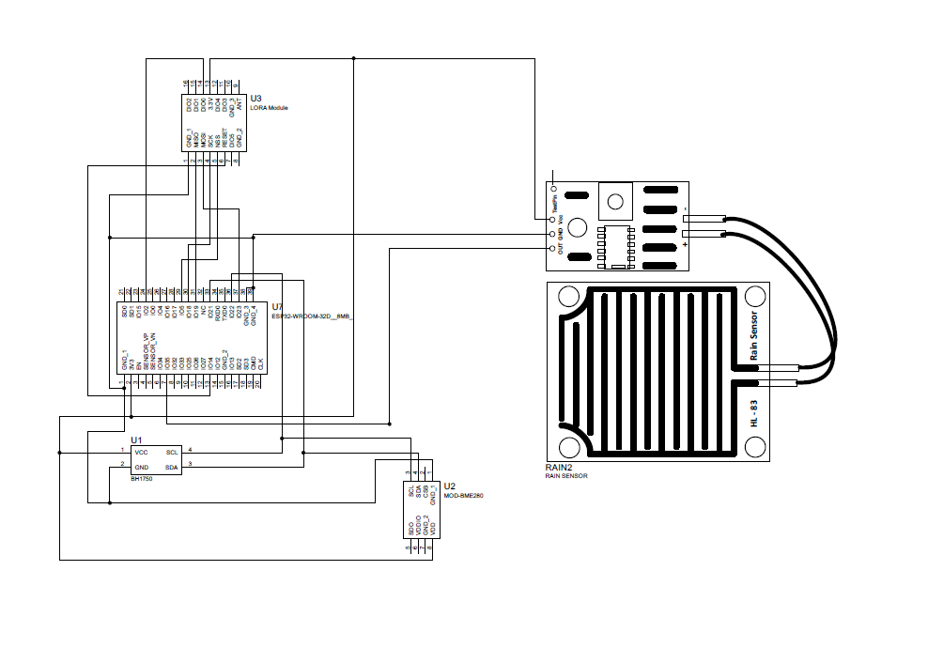
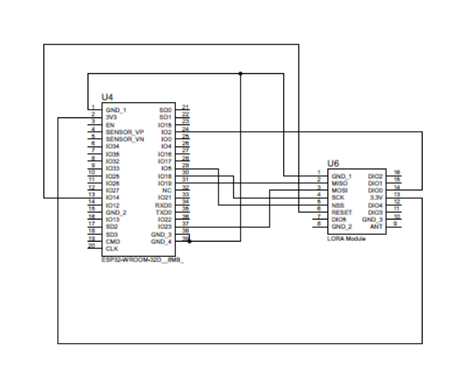
SENSOR NODE’S CIRCUIT DIAGRAM
GATEWAY NODE’S CIRCUIT DIAGRAM

Slide 9
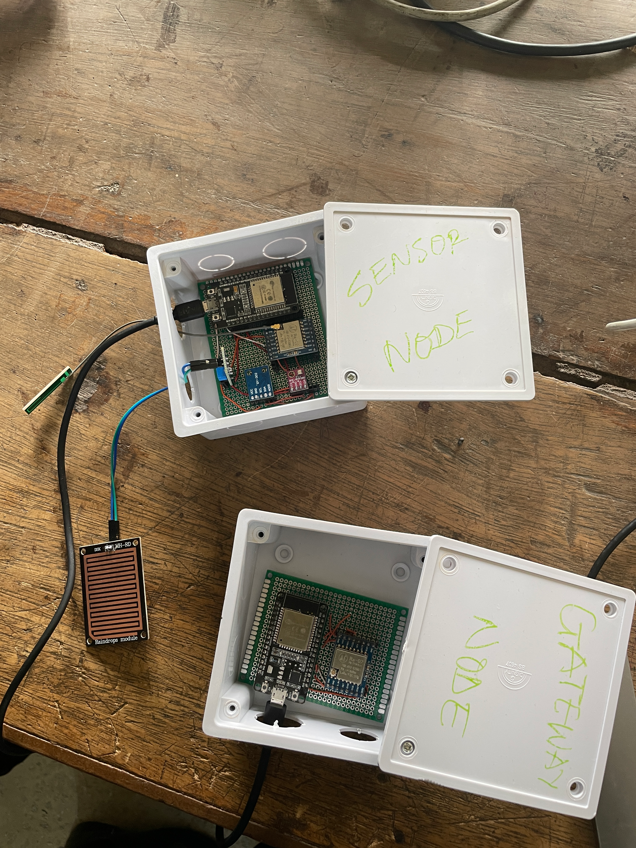
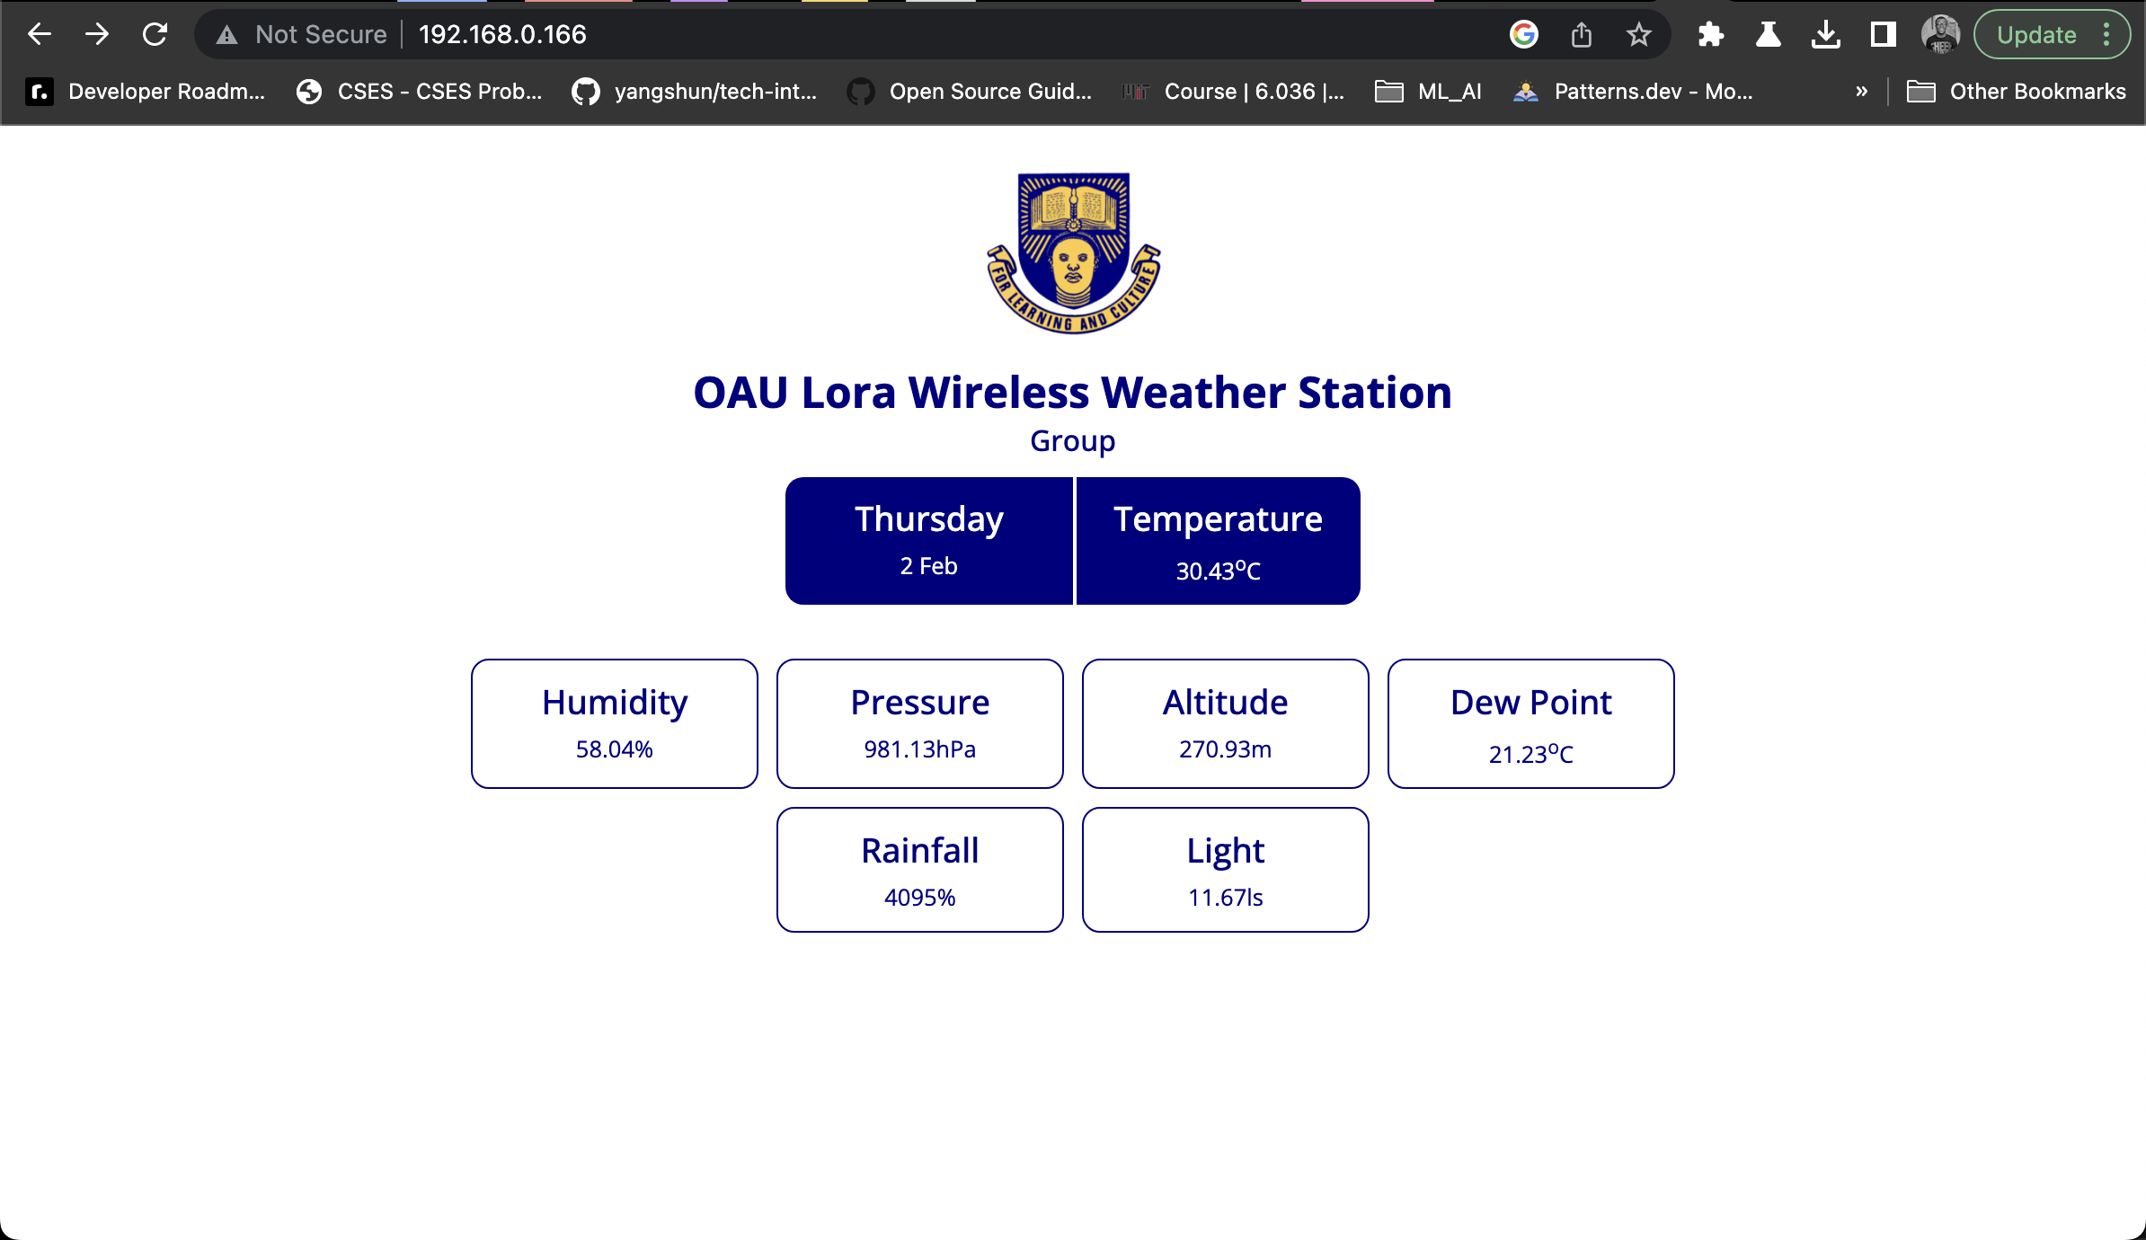
RESULTS

Slide 10
IMPACTS
SDG 2 (Zero Hunger): Weather information helps farmers make informed decisions
about planting, irrigation, and harvesting, leading to more sustainable and
productive agriculture.
SDG 13 (Climate Action): By providing accurate data on weather patterns and conditions,
weather stations can help us better understand the impact of climate change and inform
actions to mitigate its effects.
SDG 14 (Life Below Water): Weather information can help us better understand ocean
currents and patterns, which are important for managing marine resources and
protecting marine life.
SDG 15 (Life on Land): Weather information can help us better understand the impact
of extreme weather events on ecosystems and wildlife, and inform conservation efforts

Slide 11
CONCLUSIONS AND RECOMMENDATIONS
The purpose of this work was to produce a microcontroller-based weather station considering
the importance of the availability of weather-related data. The microcontroller was successful in fetching data from sensors.
The data recovered was sent to the web server used to store data at regular intervals.
RECOMMENDATIONS
The device can be used to monitor a particular room or place whose environmental parameters are required to be monitored.
We can add a GPS module in the design so that the location of the surrounding will also be mailed or messaged to the user
Alongside the environmental parameters.

Slide 12
THANK YOU

